Slide 1
Predictings the Severity of Traffic Accidents with Machine Learning
Darius Parker

Slide 2
Introduction
The availability of cheap and abundant computation, cheap and abundant data as well as user friendly machine learning software packages has provided the opportunity for individuals and enterprises to explore data with powerful tools and efficiency that were once not available to solve real world problems.
Motor vehicle accidents are amounts the leading cause of injury and death in the US. The purpose of this paper is to answer if popular machine learning techniques may be applied to predict the servility of traffic accidents. The findings of this report will be targeted to stakeholders interested in finding patterns and trends to make decisions to improve traffic safety

Slide 3
Data
The “Data-Collisions” example dataset provided in this course will be used for analysis. The Metadata is available by Clicking here. The dataset contains 37 features, and 194673 cases. Due to the large number of cases, SVM will not be applied. Features which may be suitable for KNN and logistic regression were selected and converted from string to integer categorical labels. Miscellaneous and redundant variables such as report numbers, incident id’s ect were excluded. Lastly, rows with missing values were removed. After cleaning, the dataset contained 183177 cases and the following 12 columns.

Slide 4
Data cont.
Examples of some features are below:
SEVERITYDESC – Severity Description. This will be our target variable, with categories 'Injury Collision' or 'Property Damage Only Collision'.
COLLISIONTYPE – Collision type ie “head on”, “read end”, “side swipe”.
JUNCTIONTYPE - Category of junction at which collision took place. Contains the following categories (ie “driveway”, “mid-block”, “intersection”)
LIGHTCOND – Lighting conditions.

Slide 5
Modeling
First, a K Nearest Neighbor classification algorithm was used to predict our target variable, SEVERITYDESC, which may have a result of either “Property Damage Only Collision” or “Injury Collision”.
Numerous trials comparing different featurs, such as the following groups: [‘ROADCOND’, ‘WEATHER’, ‘LIGHTCOND’], [‘COLLISIONTYPE, ACCIDENTYPE’]

Slide 6
Modeling Cont.
Next, KNN results were compared to logistic regression. For simplicity, only the features from our best KNN were used to compare ('COLLISIONTYPE', 'JUNCTIONTYPE'). The logistic regression model did not perform well compared KNN algorithm. A trial was also ran using logistic regression and features from our second trial above ('WEATHER', 'ROADCOND', 'LIGHTCOND'). This also yielded poor results.

Slide 7
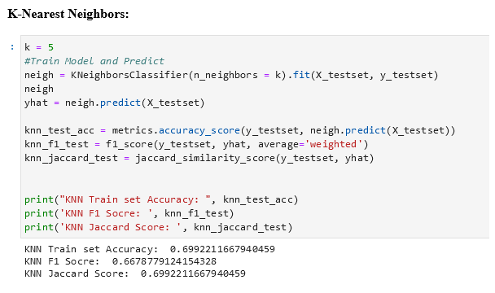
Results

Slide 8
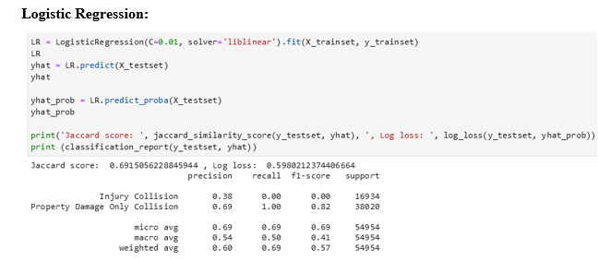
Results cont.

Slide 9
Discussion, Potential Improvements
In the process of selecting features available for each modeling trial, I noticed that many are of the nature such that a predictive model would not be needed to predict the severity of an accident (for example, an accident involving a pedestrian would likely cause an injury). This is comparable to an example presented in a previous IBM Data Science Course (example where the conclusion showed that larger house sizes correlated with higher price). The data features available which could be converted into categorical labels were limited, and a more in depth dataset could have been used. Also, it could be beneficial to create models involving the location of accidents, features such as the latitude and longitude location of the accident.

Slide 10
Conclusion
With a limited dataset, and “not so great” evaluation metrics for test datasets (see accuracy, Jaccard scores, F1 scores ect above), I would conclude that further exploration is needed in order to build a more reliable model. Additional machine learning algorithms could also be tested to determine if there are more effective ways of using machine learning to predict the severity of traffic accidents.

